Slide 1
Basic 09

Slide 2

A ROPE

Slide 3
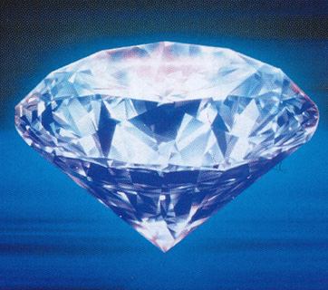
A DIAMOND

Slide 4
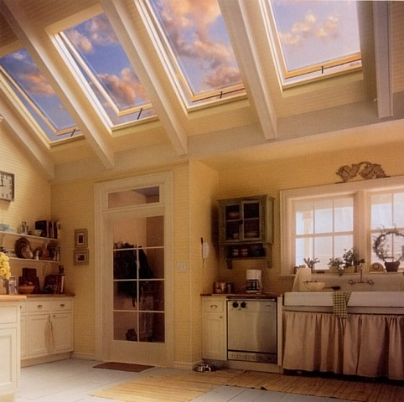
SKYLIGHTS

